Slide 1

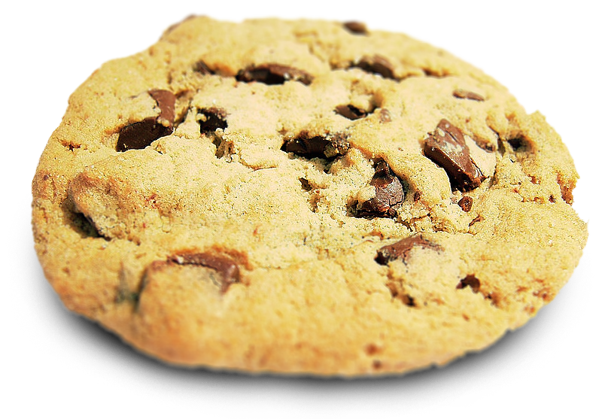

Cookies and Sessions
Charles Severance
www.dj4e.com
Cookie Image: By brainloc on sxc.hu (Bob Smith) (stock.xchng) [CC BY 2.5 (http://creativecommons.org/licenses/by/2.5)], via Wikimedia Commons

Slide 2

Browser
Linux
D
O
M
N
G
I
N X
WGSIConfig
settings.py
DJango
Click
Session
Middleware
Session
Storage
Parse
Response
urls.py
views.py
Templates
Javascript
forms.py
models.py
Database

Slide 3
Multi-User / Multi-Browser
When a server is interacting with many different browsers at the same time, the server needs to know *which* browser a particular request came from.
Request / Response initially was stateless - all browsers looked identical . This was really bad and did not last very long at all.

Slide 4
Web Cookies to the Rescue
Technically, cookies are arbitrary pieces of data chosen by the Web server and sent to the browser. The browser returns them unchanged to the server, introducing a state (memory of previous events) into otherwise stateless HTTP transactions. Without cookies, each retrieval of a Web page or component of a Web page is an isolated event, mostly unrelated to all other views of the pages of the same site.
http://en.wikipedia.org/wiki/HTTP_cookie

Slide 5
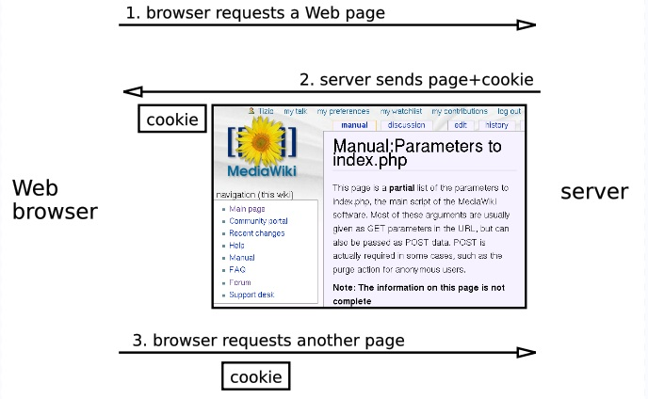
http://en.wikipedia.org/wiki/HTTP_cookie

Slide 6
Cookies In the Browser
Cookies are marked as to the web addresses they come from. The browser only sends back cookies that were originally set by the same web server.
Cookies have an expiration date. Some last for years, others are short-term and go away as soon as the browser is closed

Slide 7
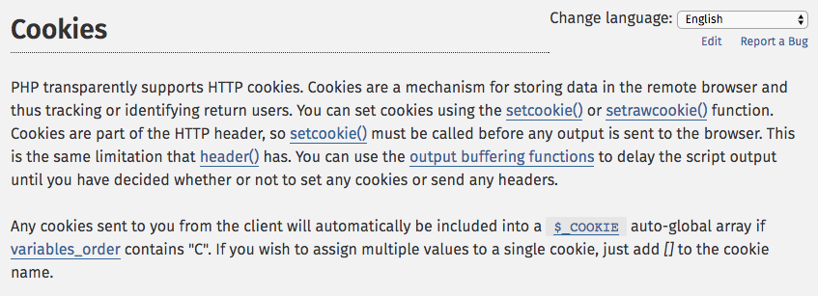
http://php.net/manual/en/features.cookies.php

Slide 8
def cookie(request):
print(request.COOKIES)
resp = HttpResponse('C is for cookie and that is good enough for me...')
resp.set_cookie('zap', 42) # No epired data = until browser close
resp.set_cookie('sakaicar', 42, max_age=1000) # seconds until expire
return resp
https://github.com/csev/dj4e-samples/blob/master/session/home/views.py

Slide 9
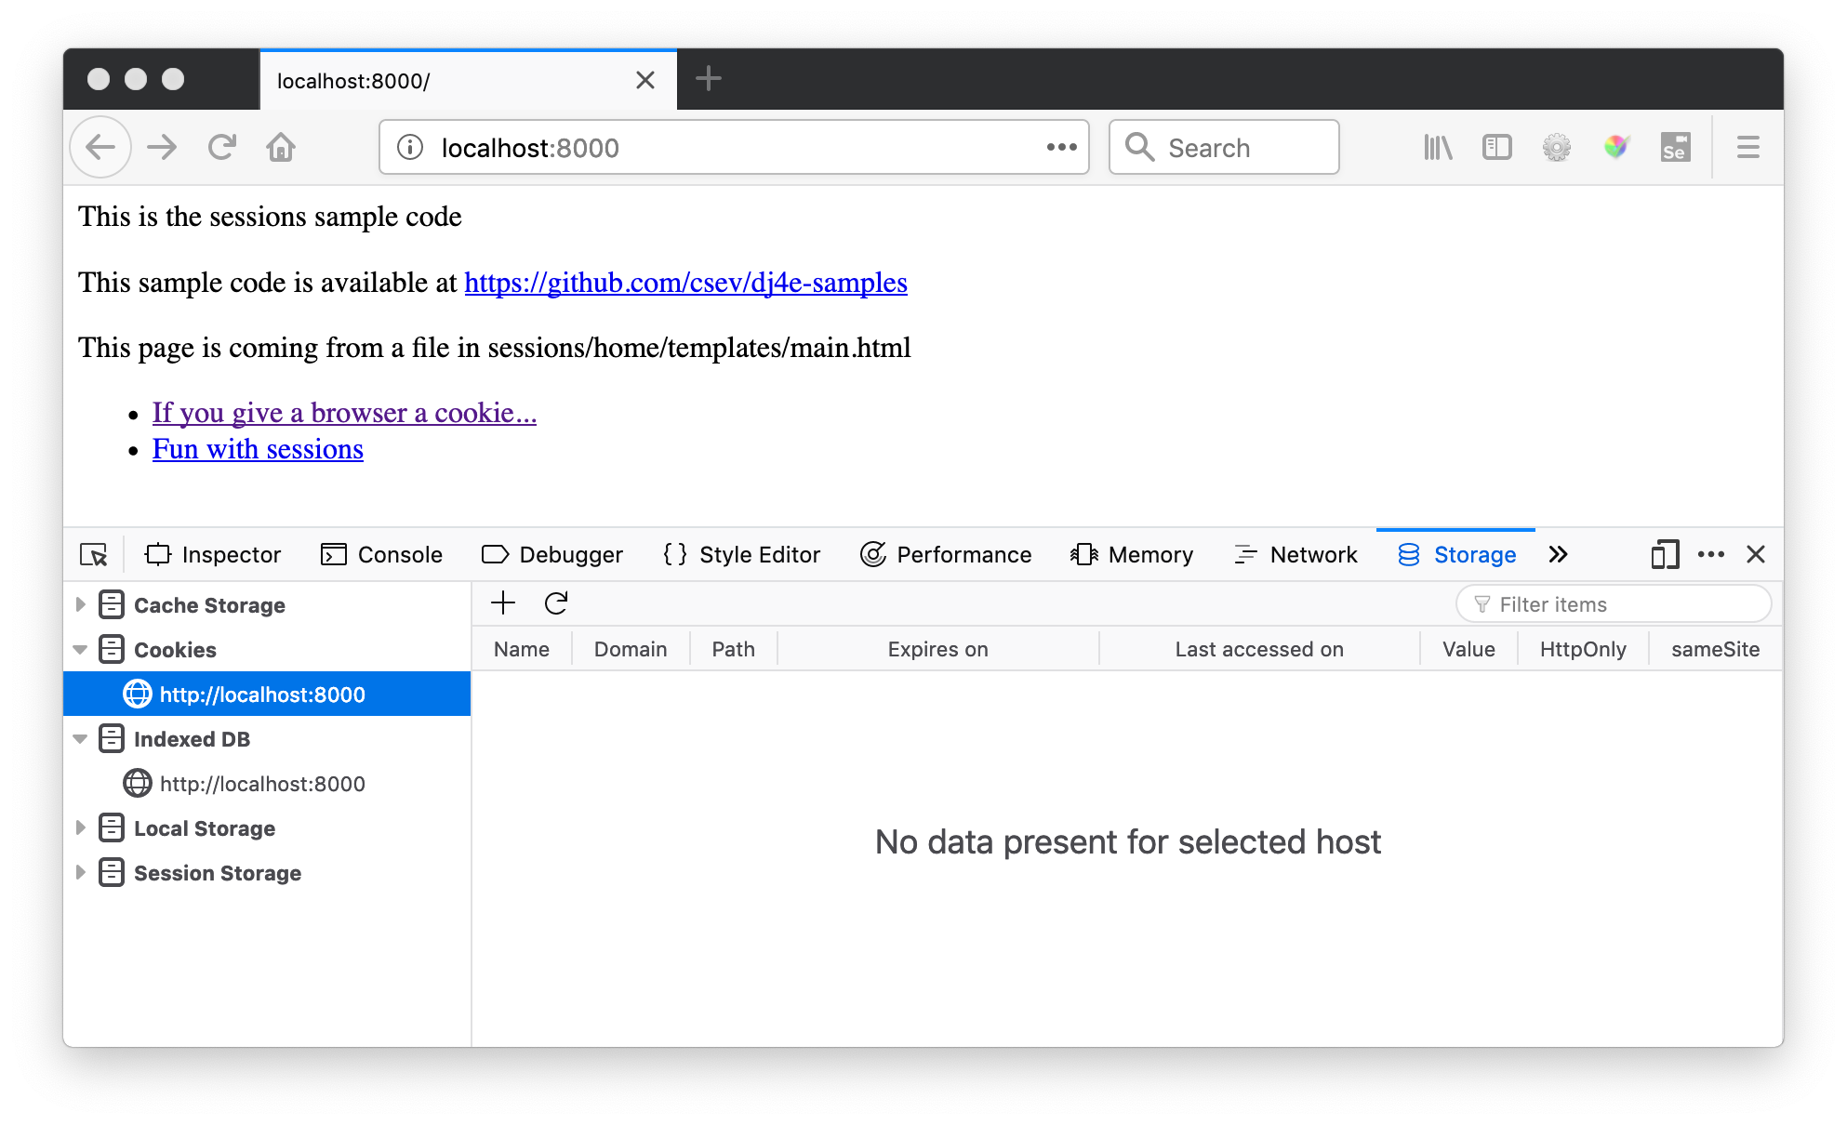
https://github.com/csev/dj4e-samples/blob/master/session/home/views.py

Slide 10
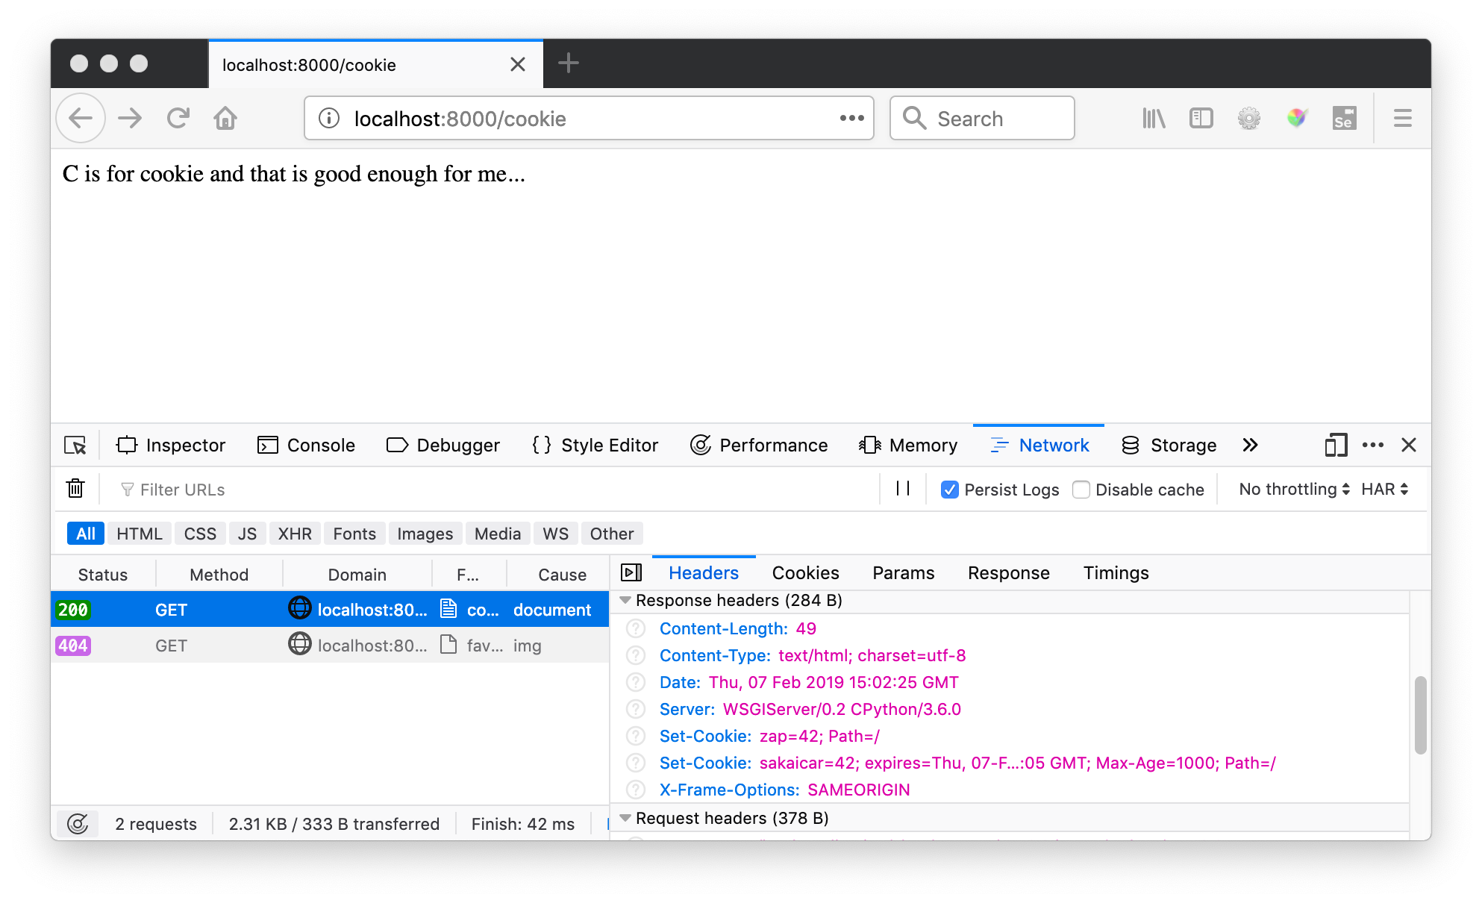

Slide 11
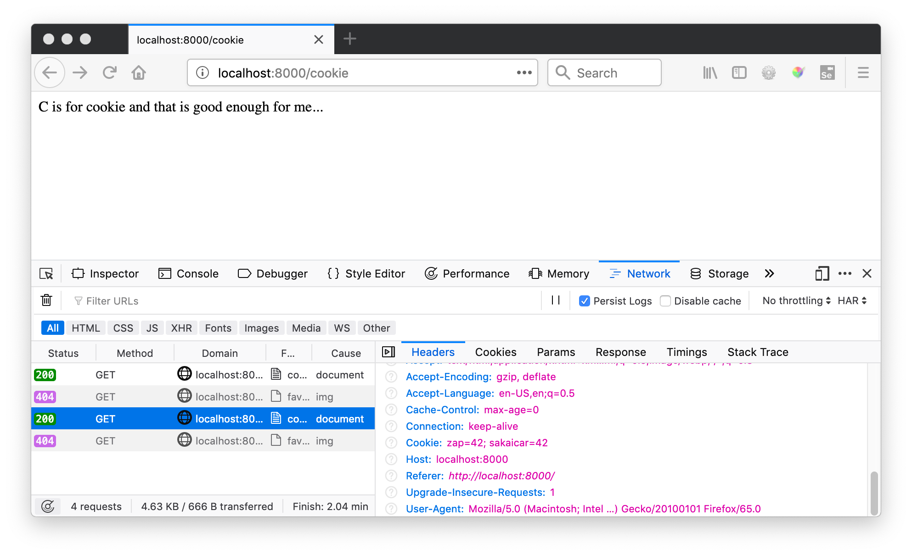

Slide 12
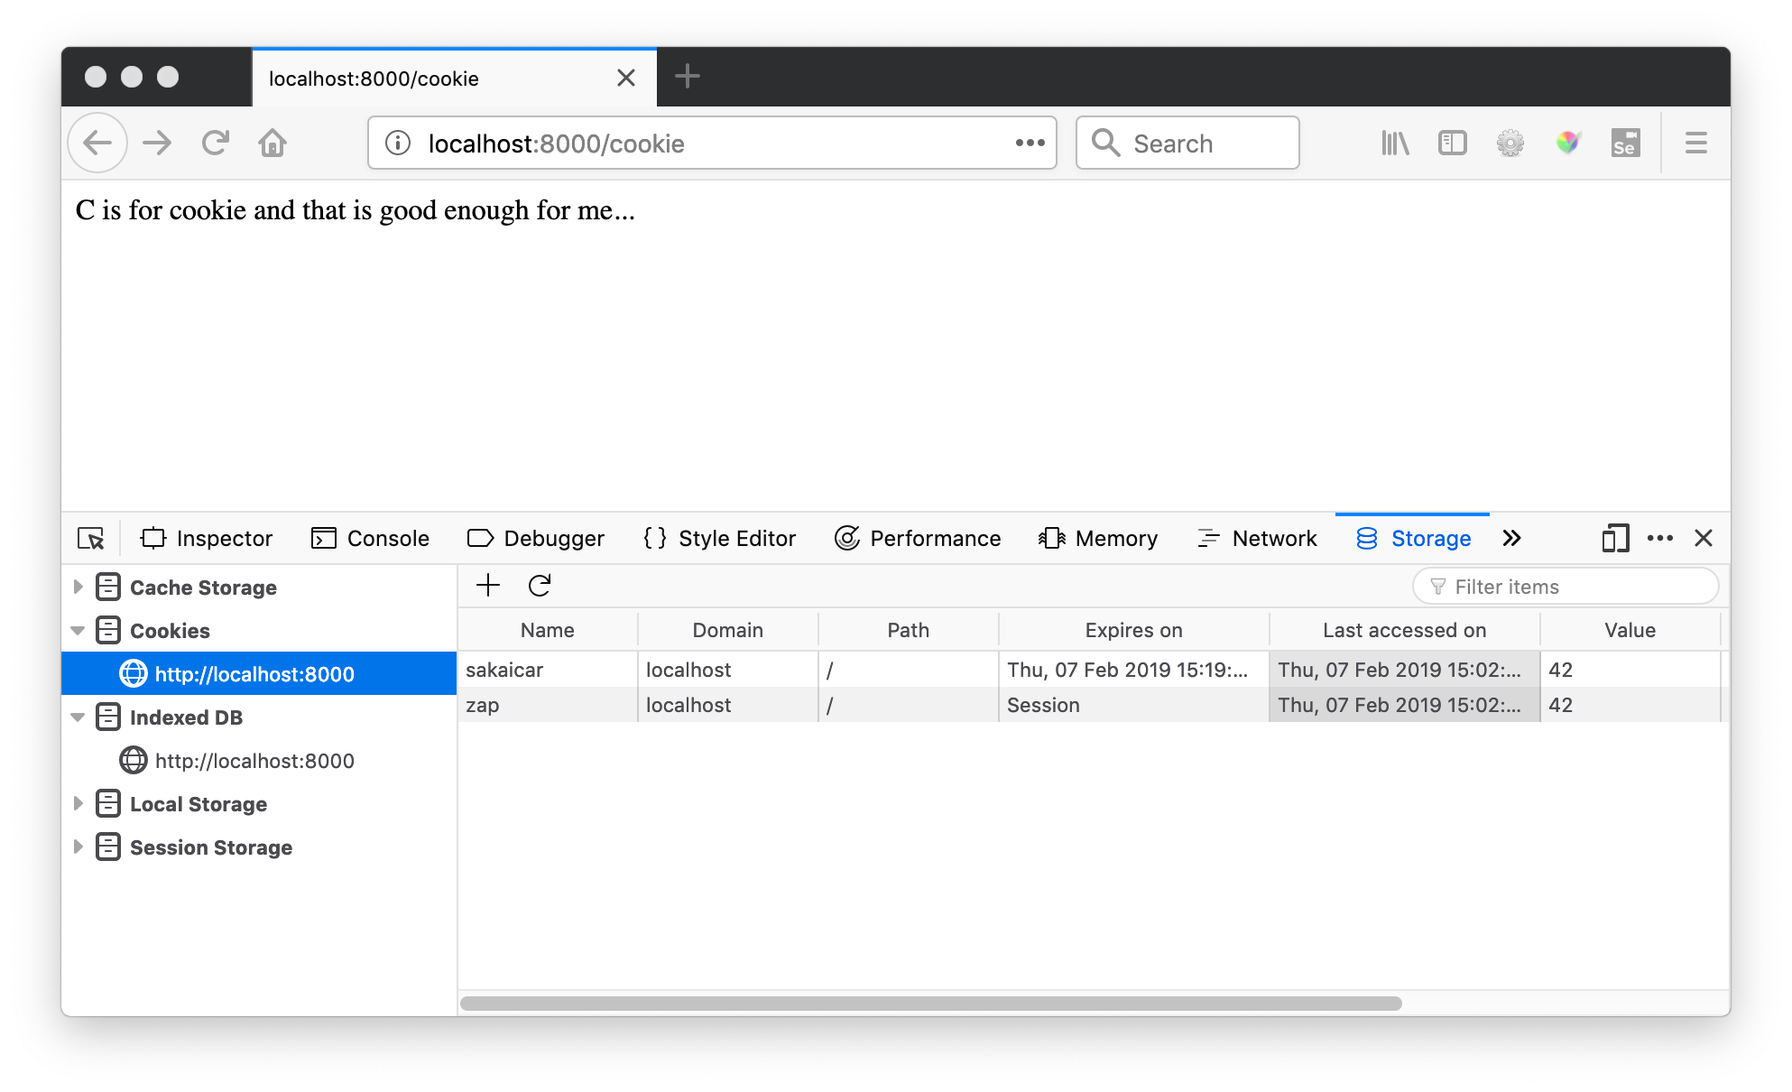

Slide 13


Time
Browser
Browser zap=42
Browser zap=42
Browser zap=42
zap=42
Apache
set_cookie()
request.COOKIES
request.COOKIES
request.COOKIES
Django
Code

Slide 14
Django Sessions
https://github.com/csev/dj4e-samples/blob/master/session/home/views.py

Slide 15
Browser
Linux
D
O
M
N
G
I
N X
WGSIConfig
settings.py
DJango
Session
Middleware
3e
Click
6f
Parse
Response
urls.py
42
views.py
Templates
Javascript
forms.py
models.py
Database

Slide 16
In the Server - Sessions
In most server applications, as soon as we start a session for a new (unmarked) browser we create a session.
We set a session cookie to be stored in the browser, which indicates the session id in use – gives this browser a unique “mark”.
The creation and destruction of sessions is handled by a Django middleware that we use in our applications.

Slide 17
Session Identifier
A large, random number that we place in a browser cookie the first time we encounter a browser
This number is used to pick from the many sessions that the server has active at any one time.
Server software stores data in the session that it wants to have from one request to another from the same browser.
Shopping cart or login information is stored in the session in the server.

Slide 18
Middleware
MIDDLEWARE = [
'django.middleware.security.SecurityMiddleware',
'django.contrib.sessions.middleware.SessionMiddleware',
'django.middleware.common.CommonMiddleware',
'django.middleware.csrf.CsrfViewMiddleware',
'django.contrib.auth.middleware.AuthenticationMiddleware',
'django.contrib.messages.middleware.MessageMiddleware',
'django.middleware.clickjacking.XFrameOptionsMiddleware',
]
https://github.com/csev/dj4e-samples/blob/master/session/session/settings.py

Slide 19
Default – Store Sessions in the Database
$ python3 manage.py migrate
Operations to perform:
Apply all migrations: admin, auth, contenttypes, sessions
Running migrations:
Applying contenttypes.0001_initial... OK
Applying auth.0001_initial... OK
Applying admin.0001_initial... OK
Applying admin.0002_logentry_remove_auto_add... OK
...
Applying auth.0009_alter_user_last_name_max_length... OK
Applying sessions.0001_initial... OK

Slide 20
Space
Browser S=A123
Browser S=B345
Browser S=C678
Web Server
Django Session Middleware
A123
B345
C678

Slide 21
Time
Browser S=C123
Browser S=C123
Browser S=C123
Browser S=C123
Django
request
POST
session
request
GET
session
request
POST
session
...
request
POST
session
C123

Slide 22
Django Sessions
The incoming request object has a session attribute that we can treat like a dictionary that persists from request to request
As long we have the session middle ware enabled and the database table, we just use it in our views

Slide 23
def sessfun(request) :
context = {'zap' : '42' }
num_visits = request.session.get('num_visits', 0)
request.session['num_visits'] = num_visits + 1
return HttpResponse('view count='+str(request.session['num_visits']))
https://github.com/csev/dj4e-samples/blob/master/session/home/views.py

Slide 24
https://github.com/csev/dj4e-samples/blob/master/session/home/views.py

Slide 25
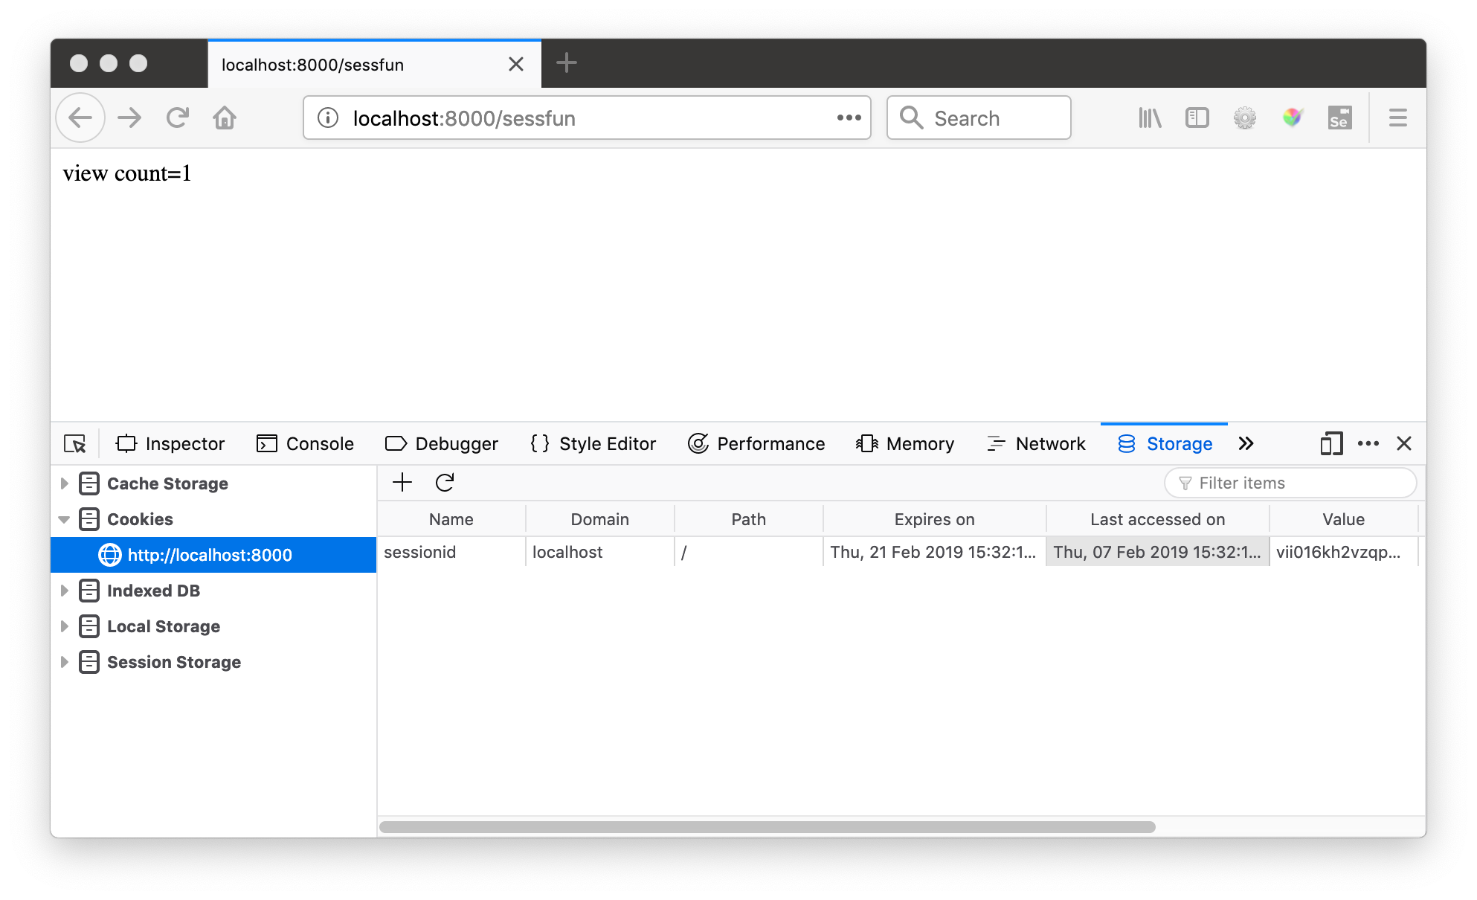

Slide 26


Slide 27
Summary
HTTP Cookies
Sessions
Using Sessions in Django

Slide 28
Acknowledgements / Contributions
These slides are Copyright 2010- Charles R. Severance (www.dr-chuck.com) as part of www.wa4e.com and made available under a Creative Commons Attribution 4.0 License. Please maintain this slide in all copies of the document to comply with the attribution requirements of the license. If you make a change, feel free to add your name and organization to the list of contributors on this page as you republish the materials.
Initial Development: Charles Severance, University of Michigan School of Information
Insert new Contributors and Translators here including names and dates
Continue new Contributors and Translators here
Notes:
Note from Chuck. Please retain and maintain this page as you remix and republish these materials. Please add any of your own improvements or contributions.

